Slide 1
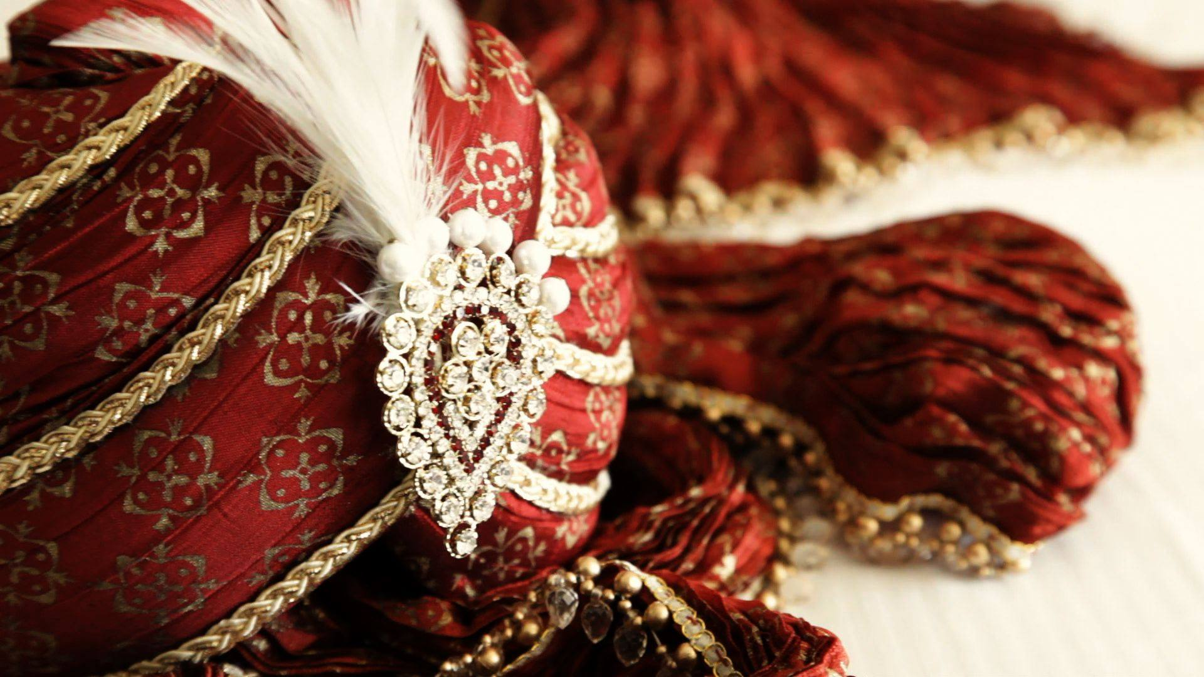
Sea Hawk Events Pvt. Ltd.
Sea Hawk Events is an Indian Wedding Planner, Specializing in Planning and Executing Luxury and Destination Weddings.

Slide 2
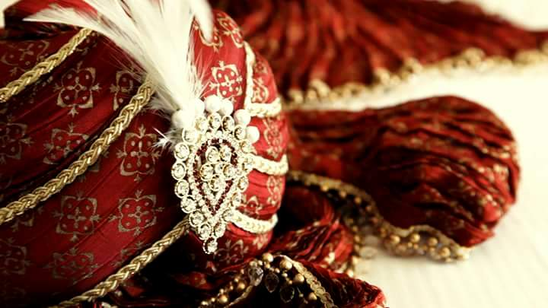
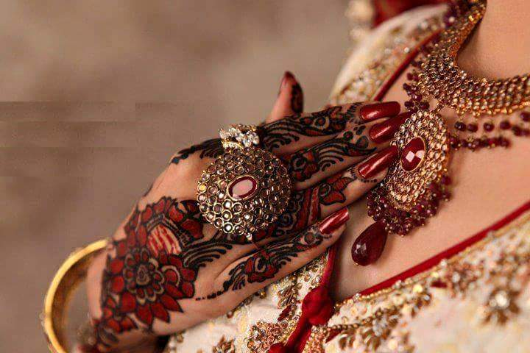
About Us
Sea Hawk Events is a professional event management company based in Delhi. A company which started off as a Wedding Themes Designer & Manufacturing unit only, but to fulfill the increasing expectations of its eminent clients, re-christened itself as a full fledged Wedding Planning company in the year 2005, which provided that extra thrust to its existing capabilities.
Sea Hawk Event is well known for its very high quality for organizing big fat weddings and also known for its unique ideas, impeccable design thinking and flawless execution amongst its elite clientele and beat the competition as Professional Wedding Planner to deliver our best services to our clients.
We have done successful weddings with our experience of planning for more than 400 in past 10 years and still organizing weddings with unique and personalized themes weddings which makes beautiful impact on your valuable guest.
We strive hard to remain leader in the industry, providing service to the client who value quality and excellence.
We also have an able team of event managers who monitor the smooth progress and execution of plans. The various divisions of our diverse services work together to create a well orchestrated event. Our creativity and innovation never fails to amaze . If you want your wedding to be a hassle free and stupendous affair , give us this opportunity to serve you and you will be well pleased
A wedding by Sea Hawk Events ensures unique menus designed for each ceremony, gorgeous choices of indoor and outdoor venues, comfortable accommodation for your guests, and an expert team that thrives on making every detail of the event extravagant, elegant and lively

Slide 3
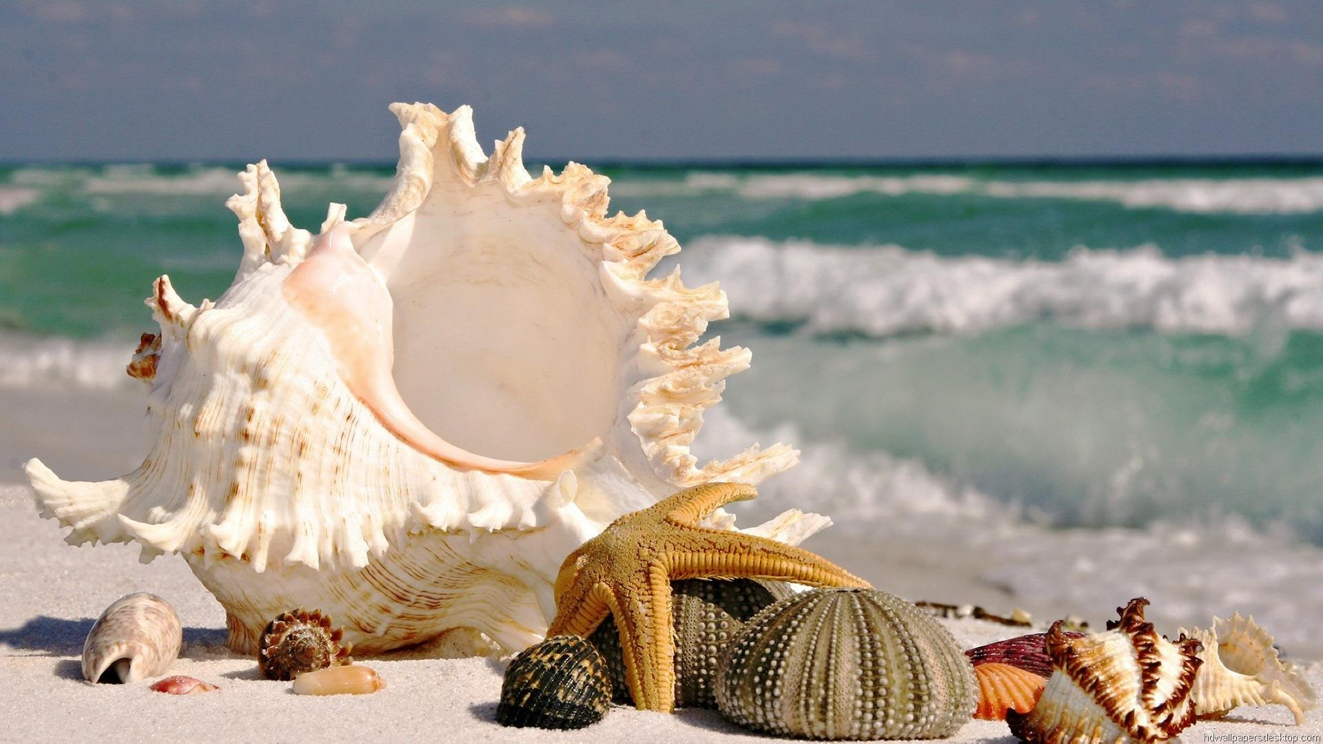
Wedding Planning Process
@Sea Hawk Events
Single Point of Contact
Understanding & Wedding Style
Venue Design and Production
Event Planning
Entertainment & Artist Management
Travel &
Logistics
Vendor
Management
Traditional/Classic
Guest Expected- Function Wise
Location Preference
Local
Destination
Within India
Outside India
Weddings Décor Themes Should be:-
Deep and Passionate
Soft and Subtle
Natural and Organic
Contemporary and Chic
Romantic and Bridal
Unusual and Fresh
Food Style
Buffet Dinner
Seating Formal Dinner
Seated Family Style
The way you want your guest to feel
Specific Don'ts
Venue Identification
Requirement Analysis
Concept & Theme Derivation
Creation of Design & Layout
Décor, Set-Up & Event Production
Dance Troupe Booking
Artist Availability & Booking
Co-ordination
Boarding & Lodging
Food
Sound & Lights
Travel & Stay
Mode of Travel
Booking of Tickets
Booking of Rooms
Managing-
Arrival, Departure, Airports, Hotels, Chartered Flights, Bogy etc.
Cabs
Photographers
Choreographers
Cards & Invitations
Make-Up- Artists
Gifts & Packing
Catering
Event Theme
Wedding Cards & Invitations
Wedding Menu - Designer Cards
Special Lounges for Celebrity Guests
Media Management
Layout Design & Décor
Entertainment - Sound & Lights
Celebrity & Artists
Catering & Cuisines
Couture Design
Packing & Accessories
Flow of Event –
Pre- Wedding Function
Wedding
Reception
Crew Allocation
Cuisines & Catering
Cuisine Identification for Each Event and Day
Organize and Manage Gala Dinners

Slide 4
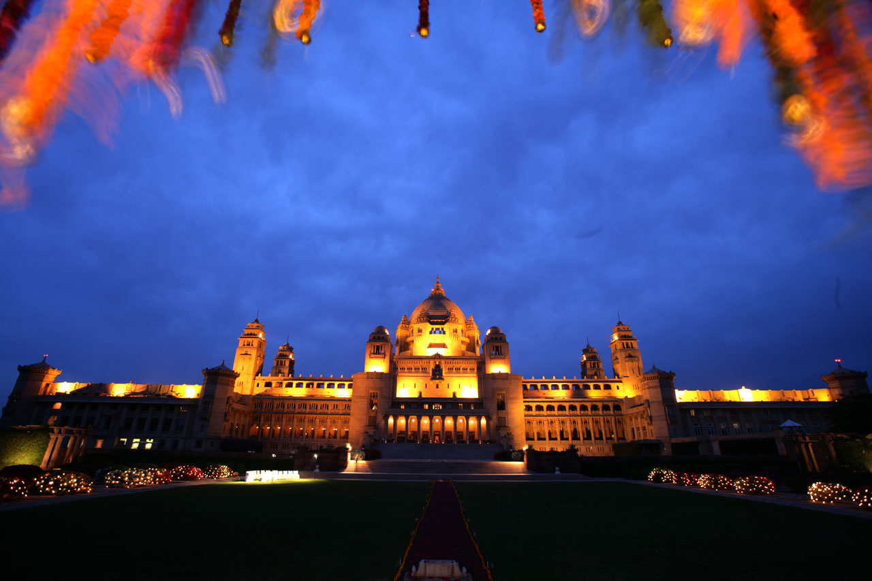
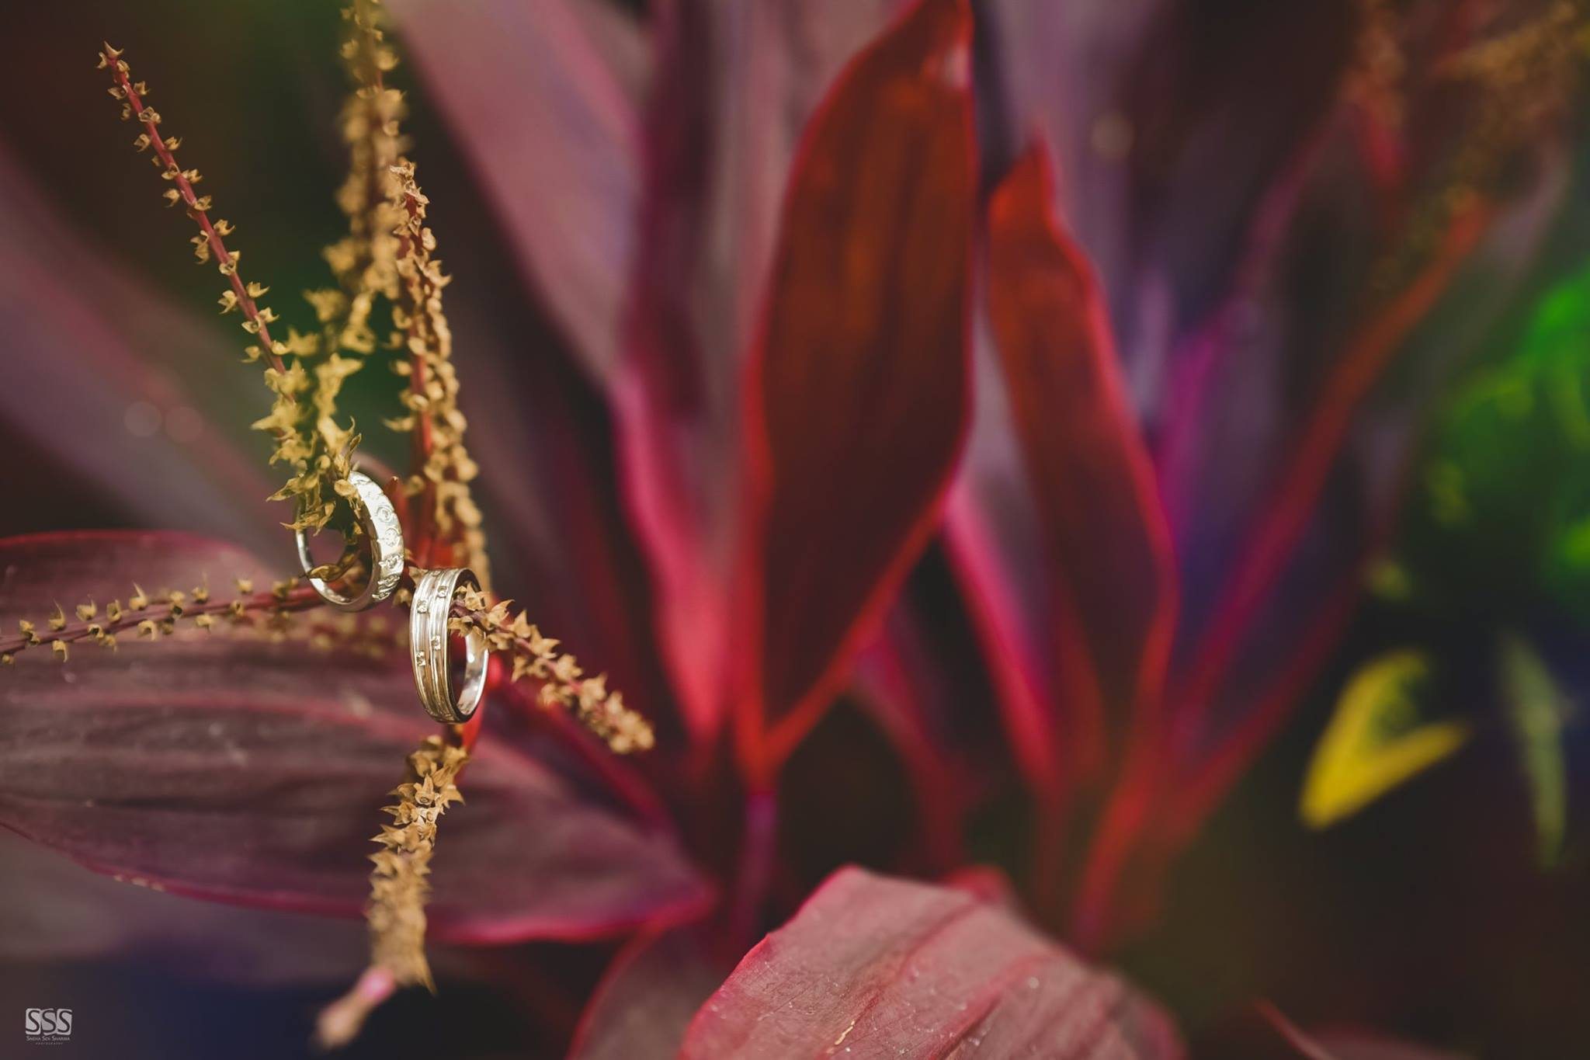
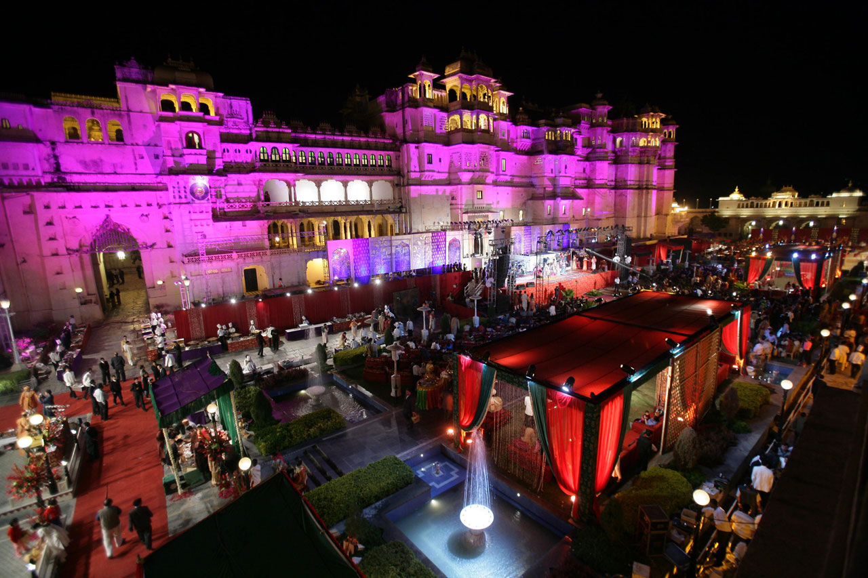
Luxury Weddings
Sea Hawk Events has much to offer to new generation couples who are getting married in today’s fast-paced world. Wedding planning which was once a trend has now become a necessity.
With schedules becoming tight and globalization of ideas taking place across the country, more and more couples resort to professional wedding planning for their big day. Couples who wish to hold destination weddings in India or Indian couples who wish to have Destination Weddings in tantalizing locations such as Mauritius, Cayman Islands, etc also seek the help of a professional Indian wedding planner for their wedding.
Sea Hawk Events is an Indian Wedding Planner, Specializing in Planning and Executing Luxury and Destination Weddings.
The scope of activities covered by Sea Hawk Events ranges from printing of Designer Wedding g Invitations to providing Shopping Assistance for Brides & Grooms, Arranging Comfortable Stays to providing Social Media Assistance , Photography and Videography to booking Honeymoon Packages.
The Wedding Planners at Sea Hawk Events understand that a Wedding in India is a much celebrated affair. With friends and families blending in to create unforgettable memories, this Indian wedding planner works closely with the couple and their near and dear ones to create a deeply personal function which will reflect the family’s style completely.
Talk to the Wedding Organisers at Sea Hawk Events at seahawkevents@gmail.com or Feel Free To Call :-
011- 27012745, +91- 9999986466

Slide 5
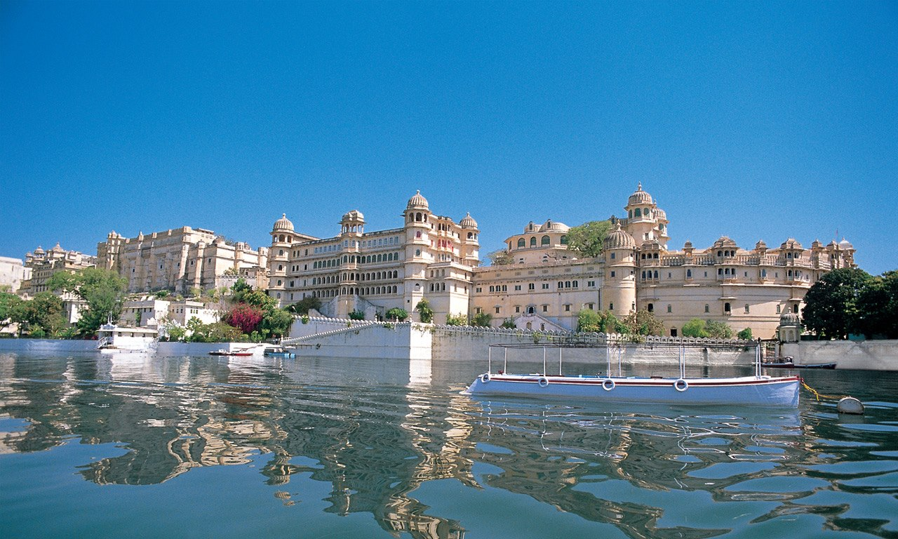
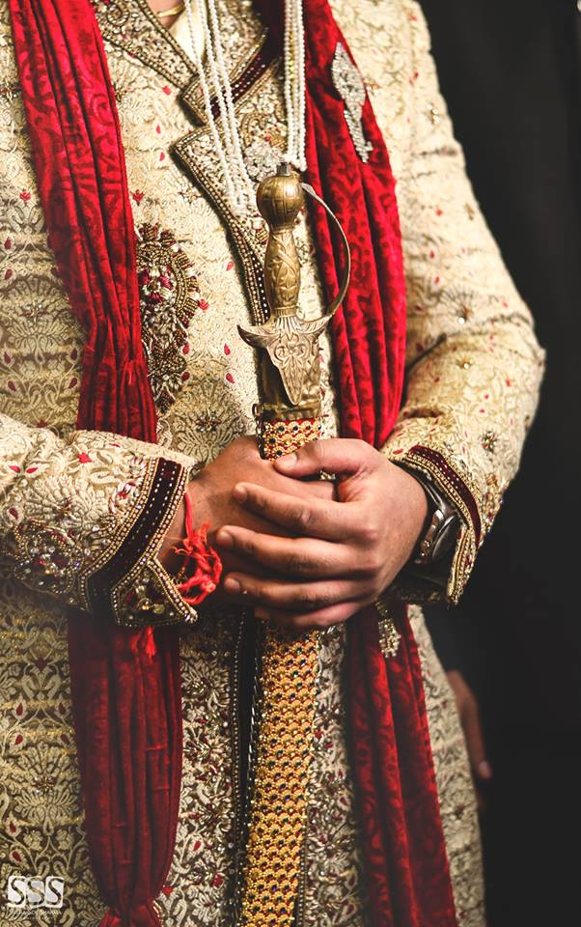
Destination Weddings
Experience of Planning & Executing for more than 30 Large Destination Weddings at Udaipur, Jaipur, Jodhpur, Goa, Delhi etc.
Coverage By Zoom TV Channel – The Big Fat Indian Wedding for two Destination Weddings Complete Planned by Sea Hawk Events at Udaipur and Goa.
Benefits of Hiring Sea Hawk Events for Planning Destination Weddings in India and Abroad
Experienced Professional Team of Sea Hawk Events ensures the Destination Wedding is
Unique
Hassle Free
Value for Money
List of Services
A Complete Destination Wedding Package Customized for you including tickets, visas (if abroad) etc.
Travel
Hotel Accommodation
Hotel Banqueting Services
Hospitality Services for Guests
Décor ( As per Desire and Lots of Customized Option)
Entertainment
(Sound, Lighting, Dance Performance, International Acts , and Most Important Jaimala Themes which is very special moment for both Bride & Groom)
Celebrity Invites as for Guest Appearance and Performing Live on Stage

Slide 6
Catering
Caterer is a most important part of Wedding or Reception .
All of us know that a perfect Wedding Function relies on Finest Catering Service with Quality , Variety of Food and Most Importantly Presentation with an attire to serve people with true feelings to feel them truly got Respected and Welcomed .
We at Sea Hawk Events specialize in making your moments memorable and maintain highest standards of Hygiene , Quality and Presentation of f
Food with Crockery Services by Our company Sea Hawk Events.
All of the presentation items are chosen to accomplish your design from the table settings, the bar (if chosen), to the buffet or table service will be coordinated with your event design.

Slide 7
The Engagement Ceremony is basically a brief ritual wherein the couple exchanges Gold Rings. This ensures both the Families that the Girl and the Boy are now hooked. This is why it is also called the Ring Ceremony.

Slide 8
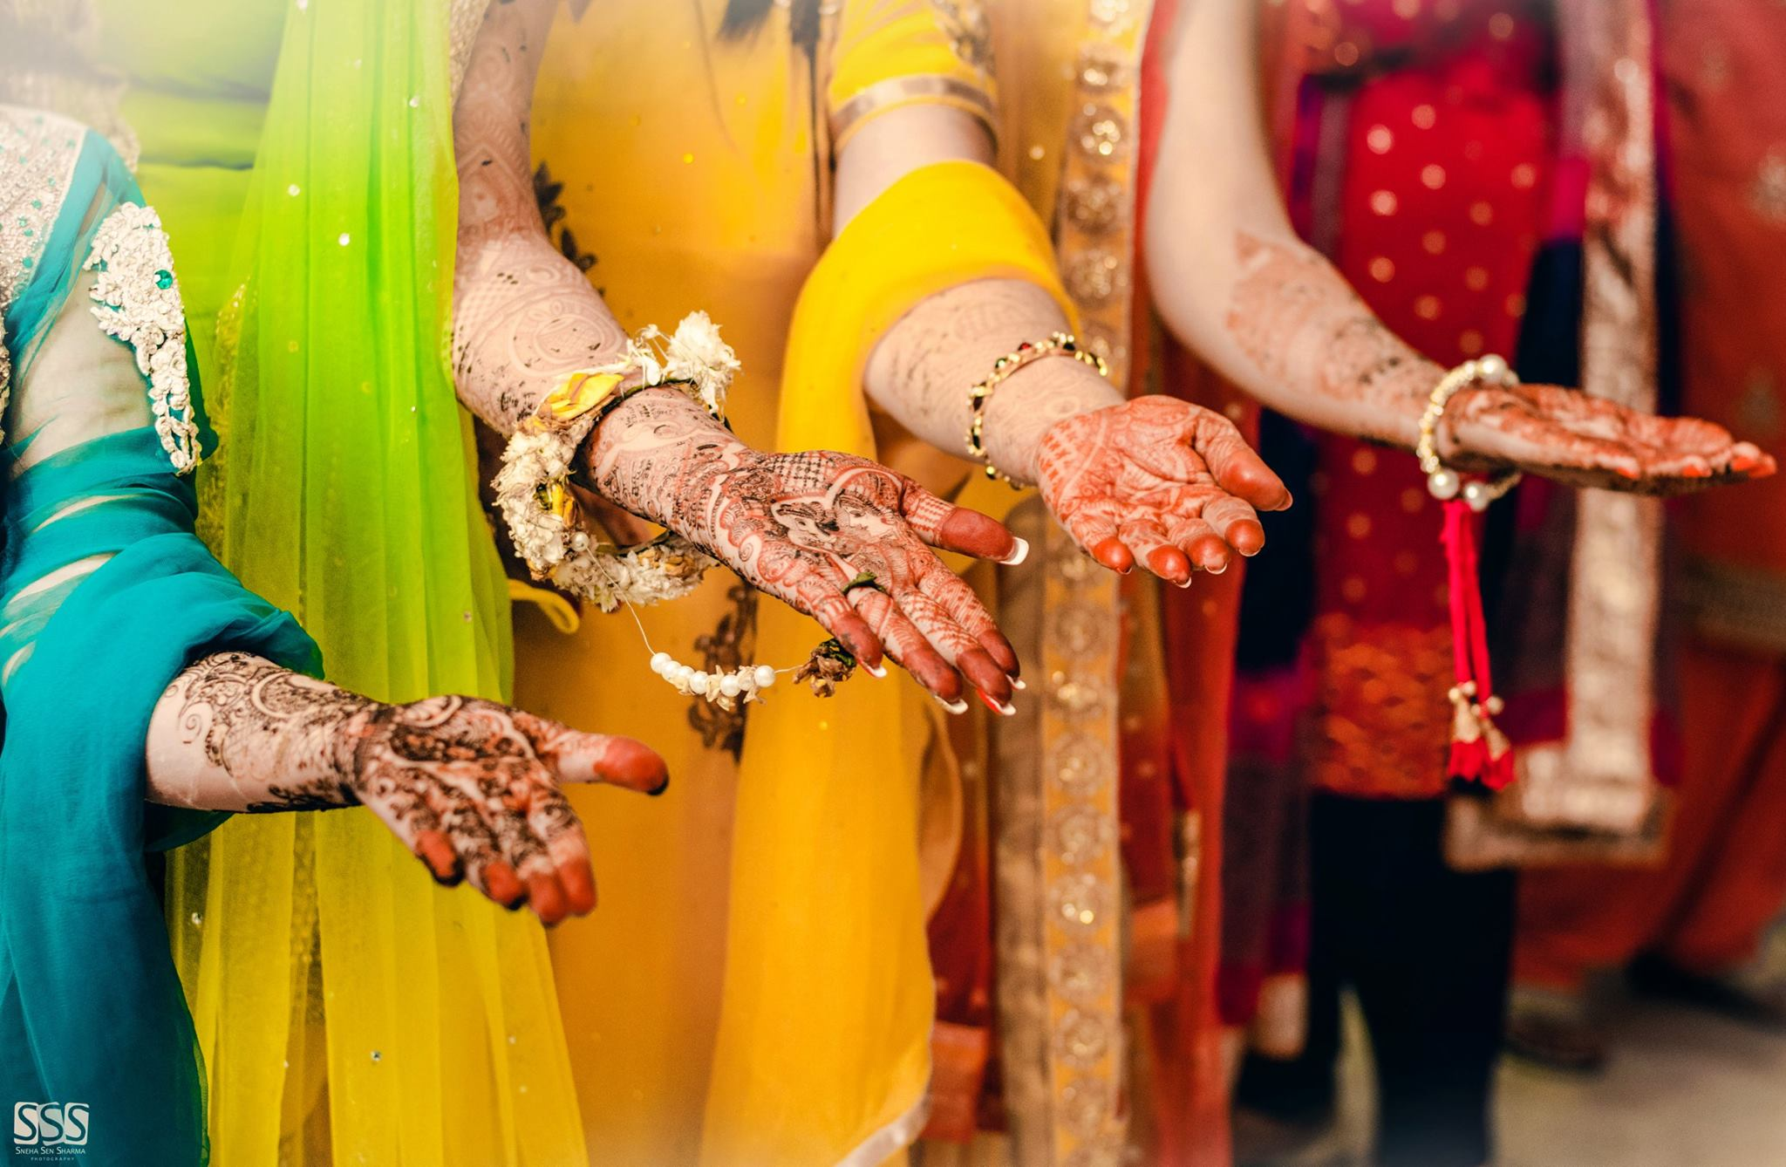
One of the most important pre-wedding ceremonies in Indian marriages is the Mehendi Ki Raat. The beautiful bride-to-be adorns her hands and feet with striking designs made out of henna

Slide 9
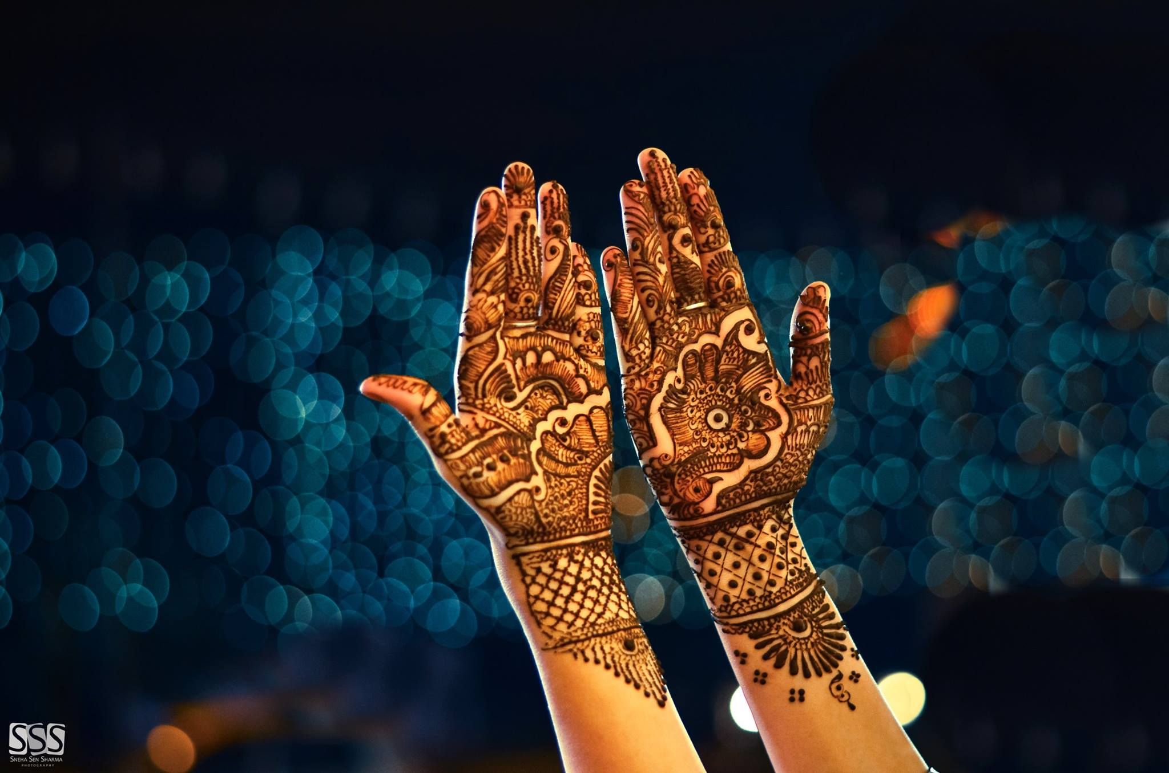
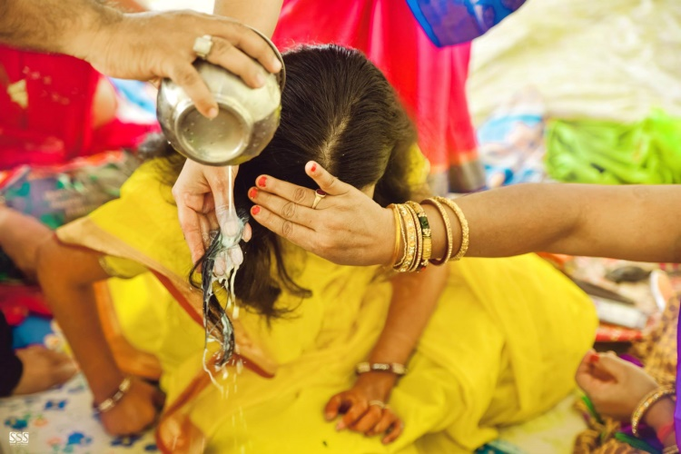
Rasam (Ritual) of Haldi (Turmeric ) is one of the famous traditional rituals followed in Indian Marriages. It is alsko called Indian Bridal glow mask as it beautify the Brides and Grooms and gives a glow to their skin.

Slide 10
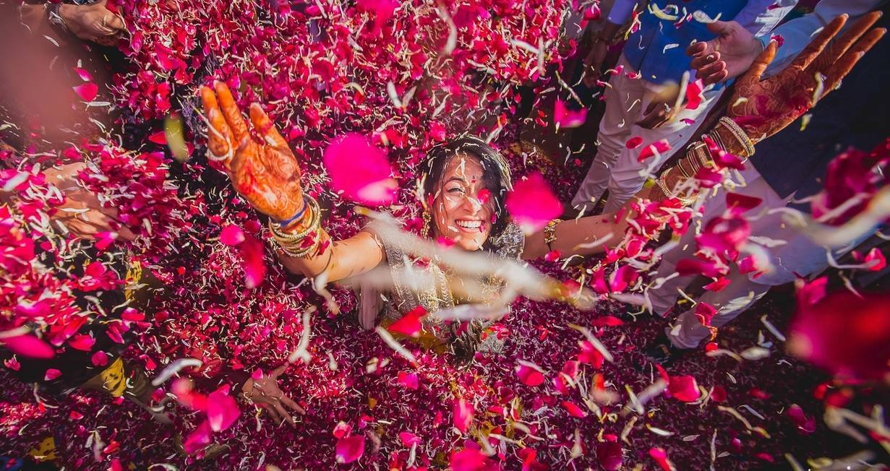
Most Important Day for Bride and Groom is Their Wedding Ceremony and we assure you Because it’s your wedding, it should be unique.
We build your dream around you.

Slide 11
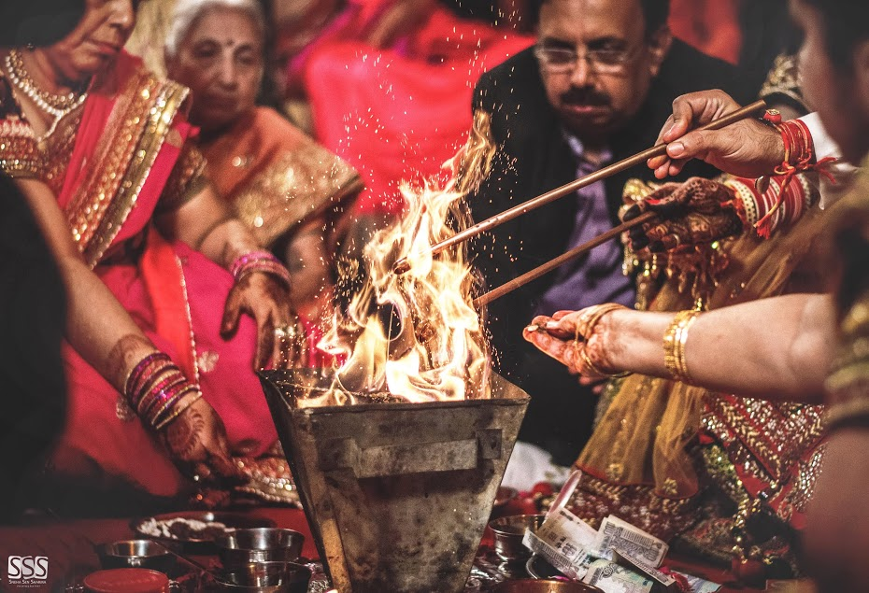
The bride and the bride groom take the vows before God, symbolized by fire and light. These seven promises taken together by the bride and groom build's the foundation of their relationship and marriage. It speaks of the loyalty, love, and commitment they would eventually share in their married life.

Slide 12
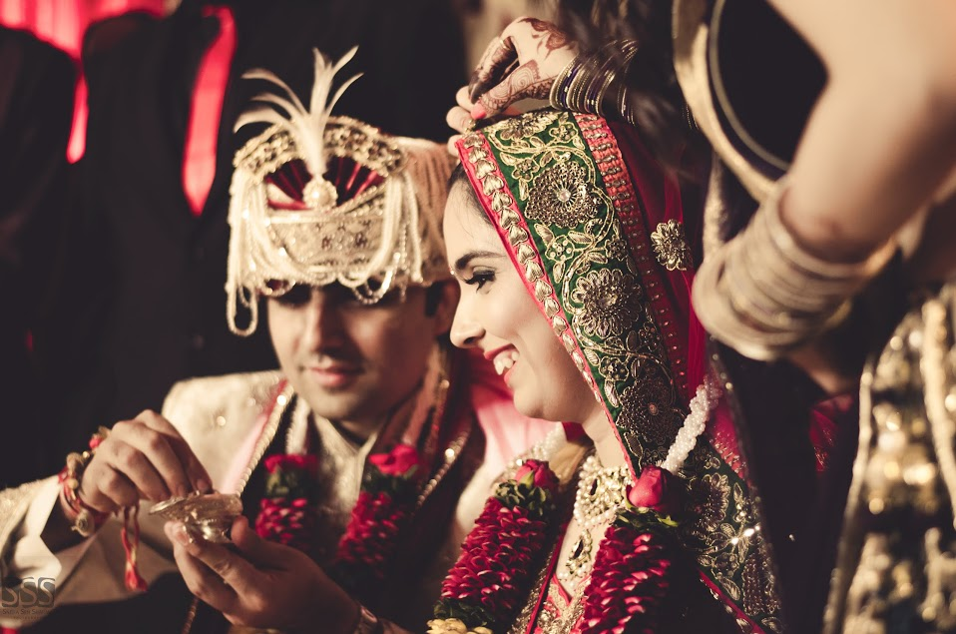
The sindoor is first applied to the woman by her husband on the day of her wedding; This is called the Sindoor Dana ceremony.

Slide 13
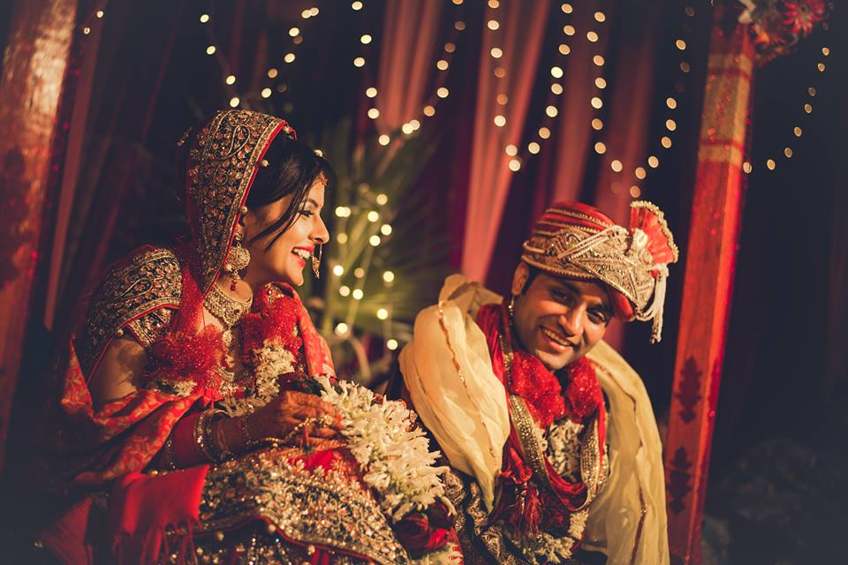
Decoration
Wedding Decorations
No Indian wedding is ever complete without elaborate wedding decorations. Colorful Indian weddings require proper preparation, planning and coordination with flower decoration in order to mirror the traditional styles and customs needed for the wedding ceremony. Many Indian couples today choose a combination of traditional and modern themes when it comes to their Wedding Decorations.
Wedding decorations include the proper preparation of the venue. So the first step once the venue has been chosen is to match the wedding decorations with the preferences of the couple. In an Indian wedding, color plays a major role in determining the décor and eventual tone of the event. In order to produce a well-coordinated wedding, it is essential that the decorations you choose abide well with the theme you have chosen.
Wedding decorations are considered to be one of the defining aspects that make Indian weddings special and quite grand in its own right. Proper preparation in coordination with the right kind of people will help ensure your wedding is a success.

Slide 14
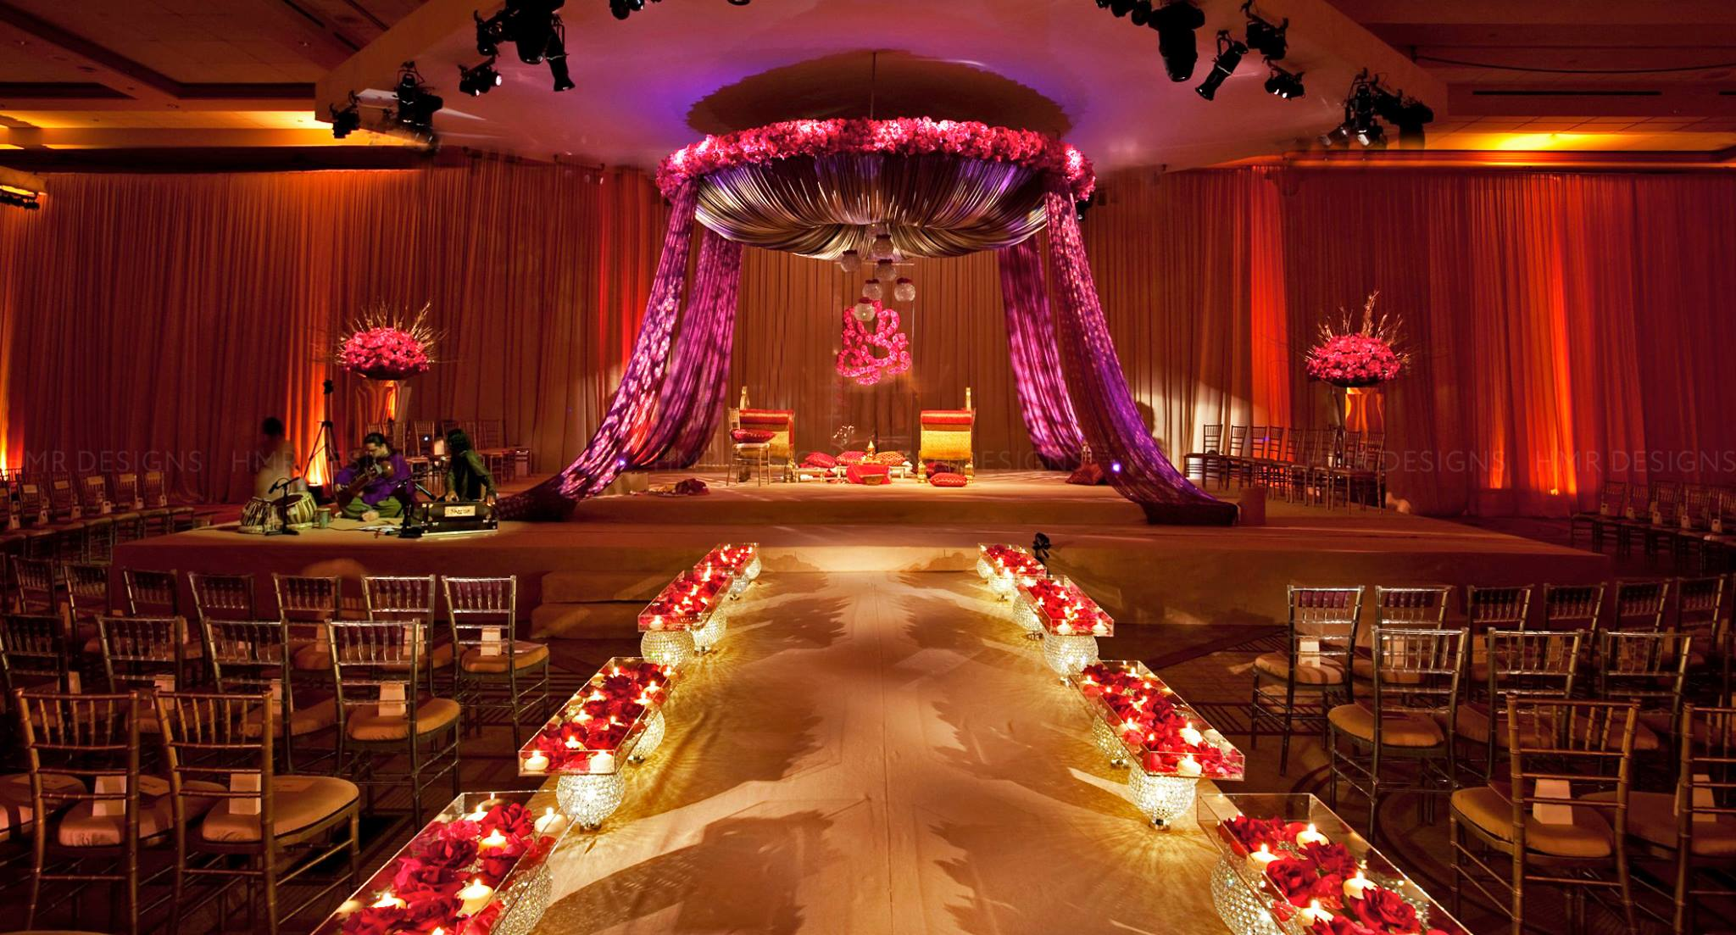
Wedding Stage & Vidhi Decorations is an important aspect in the entire celebrations of marriage ceremony.
These days, Wedding Stage Decorations are done with enhanced western touch.

Slide 15
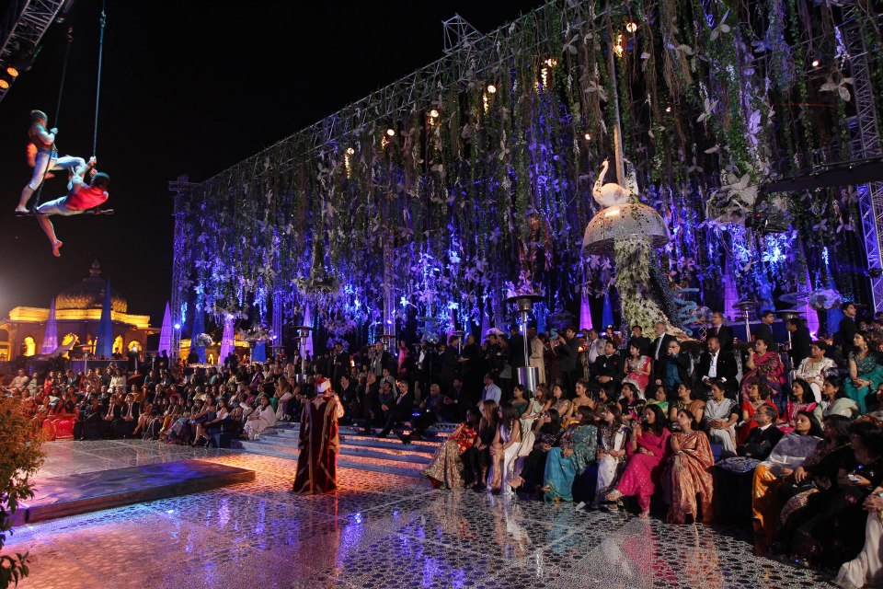
The Main Purpose of Decoration is to make the entire celebrations a memorable one.

Slide 16
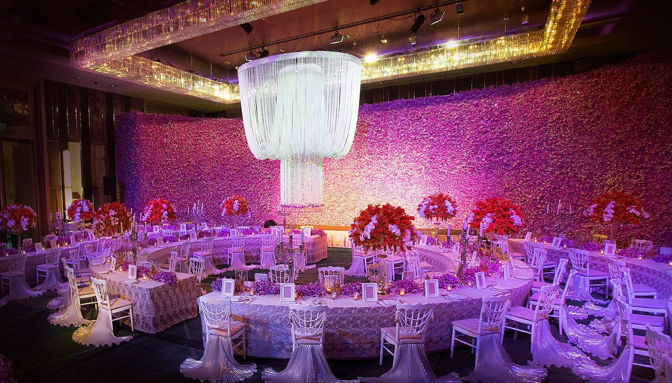
With growing trend of designer wedding, the decoration is the topmost priority of every wedding and people make sure they are spending major chunk of the budget on the proper decoration so as to make the wedding stand out in the crowd.

Slide 17
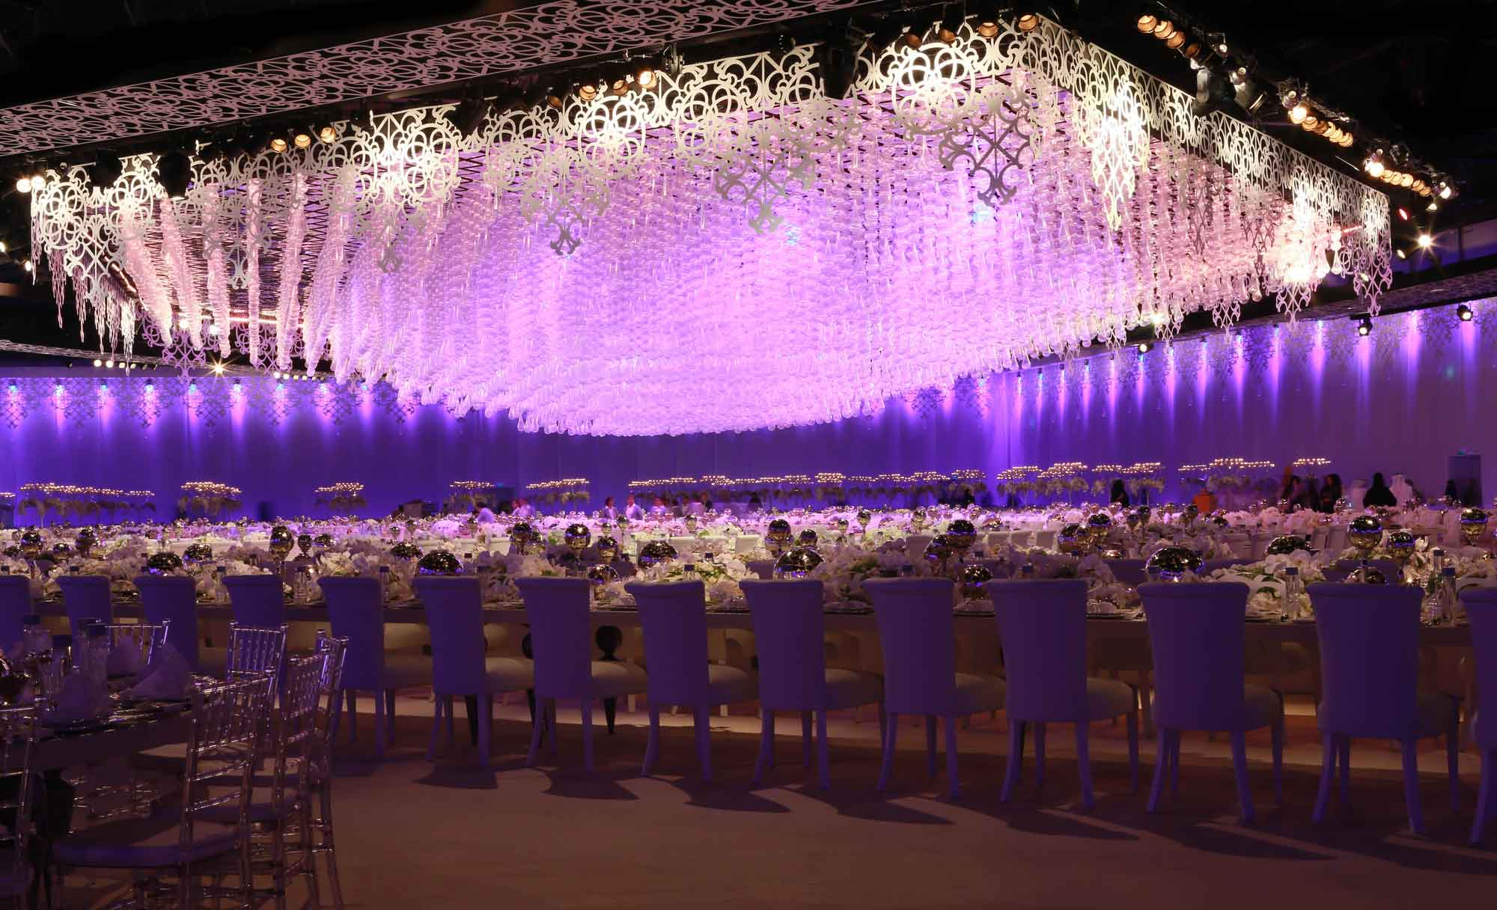
Any wedding decoration which is being done by a planner always have this professional look and it makes the whole wedding looks fabulous and the whole wedding turns out to be a memorable and exciting memory in the eyes of family and the people who attend it.

Slide 18
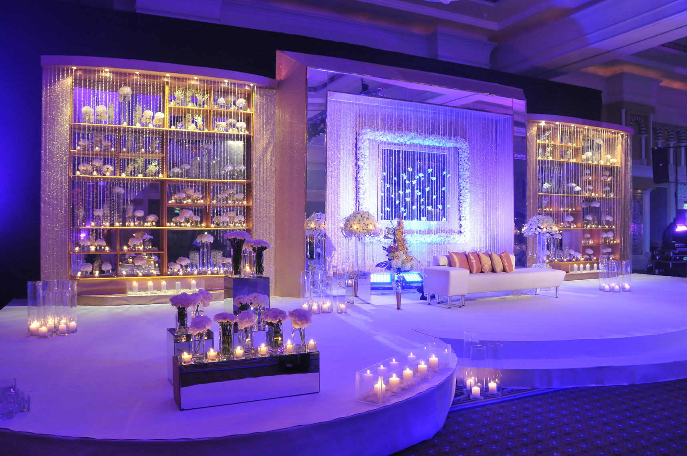
Wedding Stage plays a huge role to create the long lasting impression about your Wedding.

Slide 19
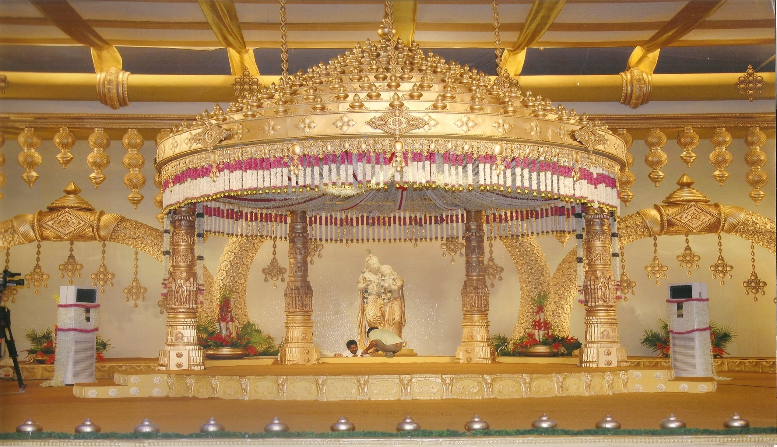
Our set designers have years of experience developing creative stage designs based on a variety of fabrics, shapes and creative look.

Slide 20
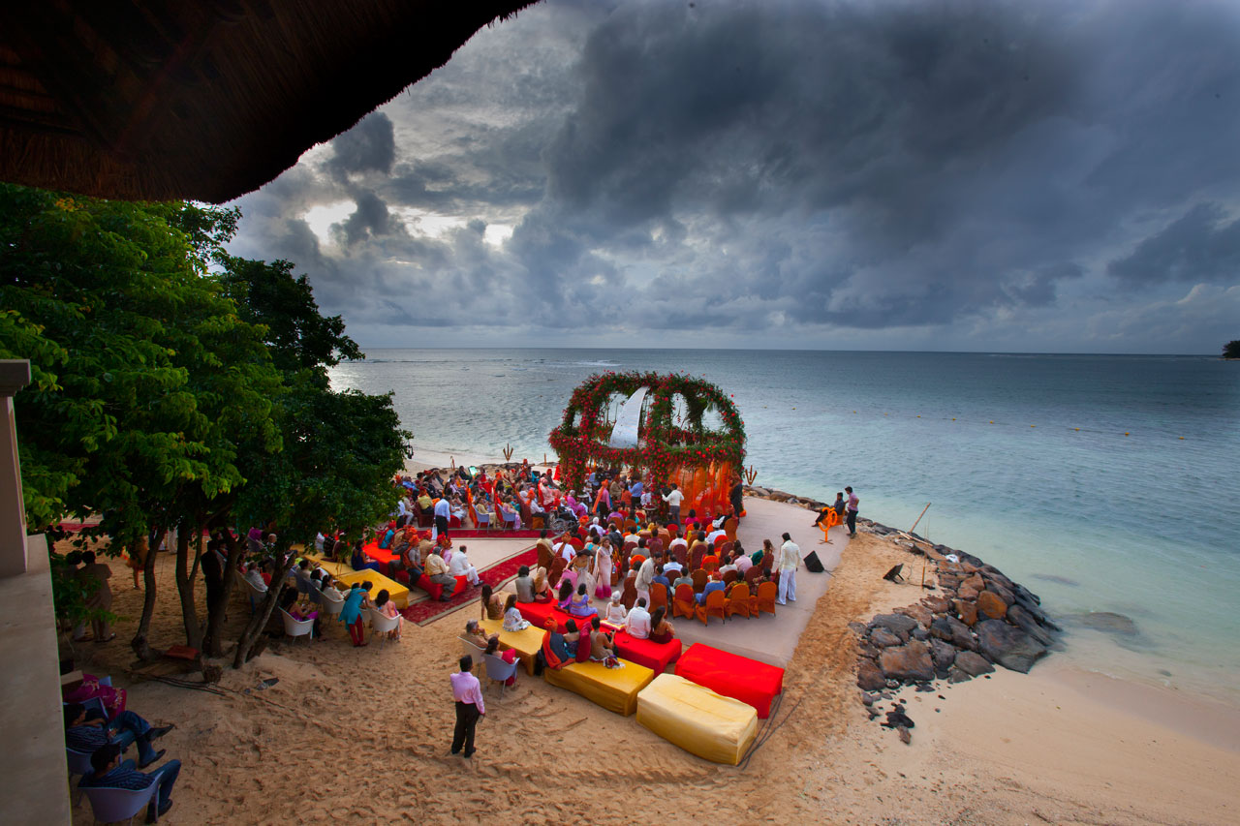
Planning Beach Wedding is Peaceful
Welcome the guests would ensure a joyful environment for all around.

Slide 21
Entertainment
We offer a wide variety of entertainment to cater to a wide variety of needs. The guests just have to pick their favorite entertainment and we will fit their budgets and needs.
Make sure your guests don’t stop partying by including a variety of entertainment at your wedding. A good DJ or band, prepped with a list of wedding music you know your guests will want to hear, will help to keep them dancing the night away.
We provide the following services for entertainment:
High Quality Sound and Lighting Setup
with Fame DJ
Wedding Choreographers • Wedding Bands • Wedding Orchestras • Wedding Singers • Musicians for weddings • Classical Dancers for leading the Bride and groom for Varmala or ring exchange • Entertainment wedding receptions • Live bands for Weddings Reception • Folk Dance Parties for Receptions/ Gala Dinners
Celebrity Invites for Live Performance
Lots of Entertainment Options like Belly Dancers, International Dancers & Acts , Bartenders if there is Bars Setup Requirement

Slide 22
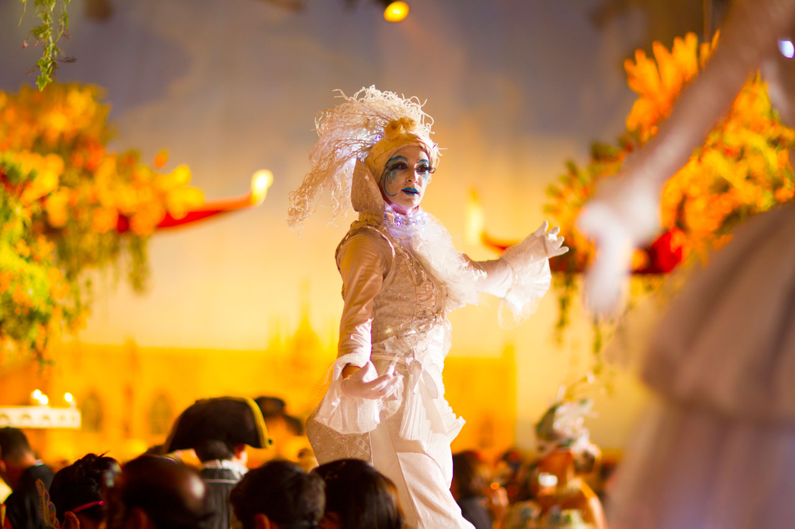
Celebrate the beauty of dance through an unforgettable experience!

Slide 23
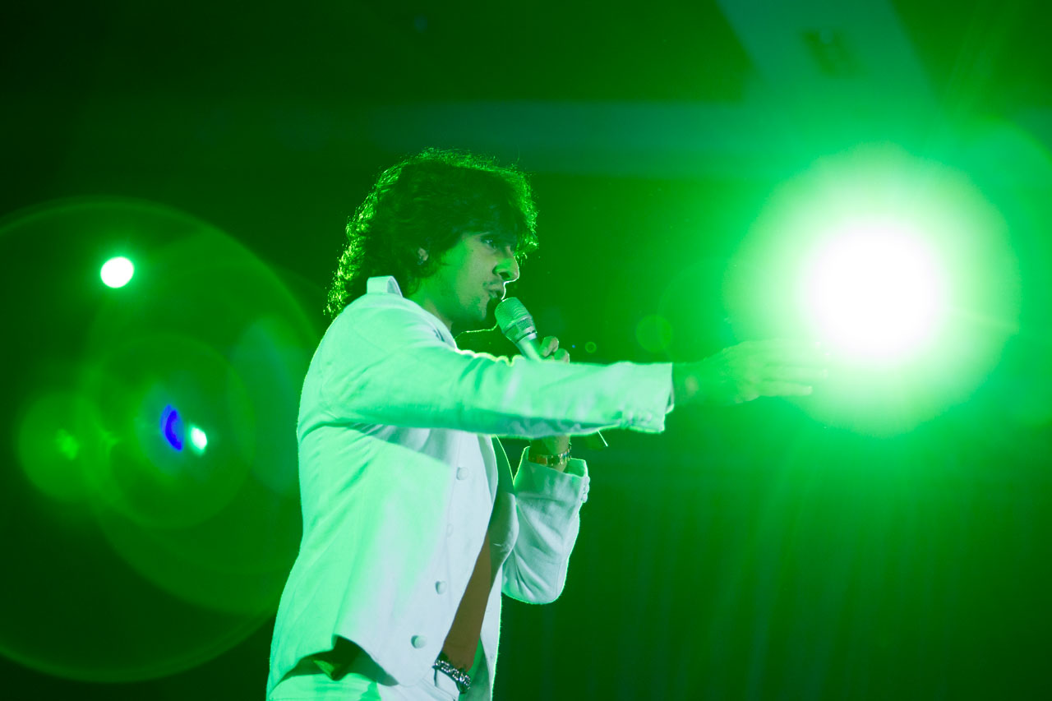
You can really add a touch of celebrity to your wedding party to make your wedding most memorable .

Slide 24
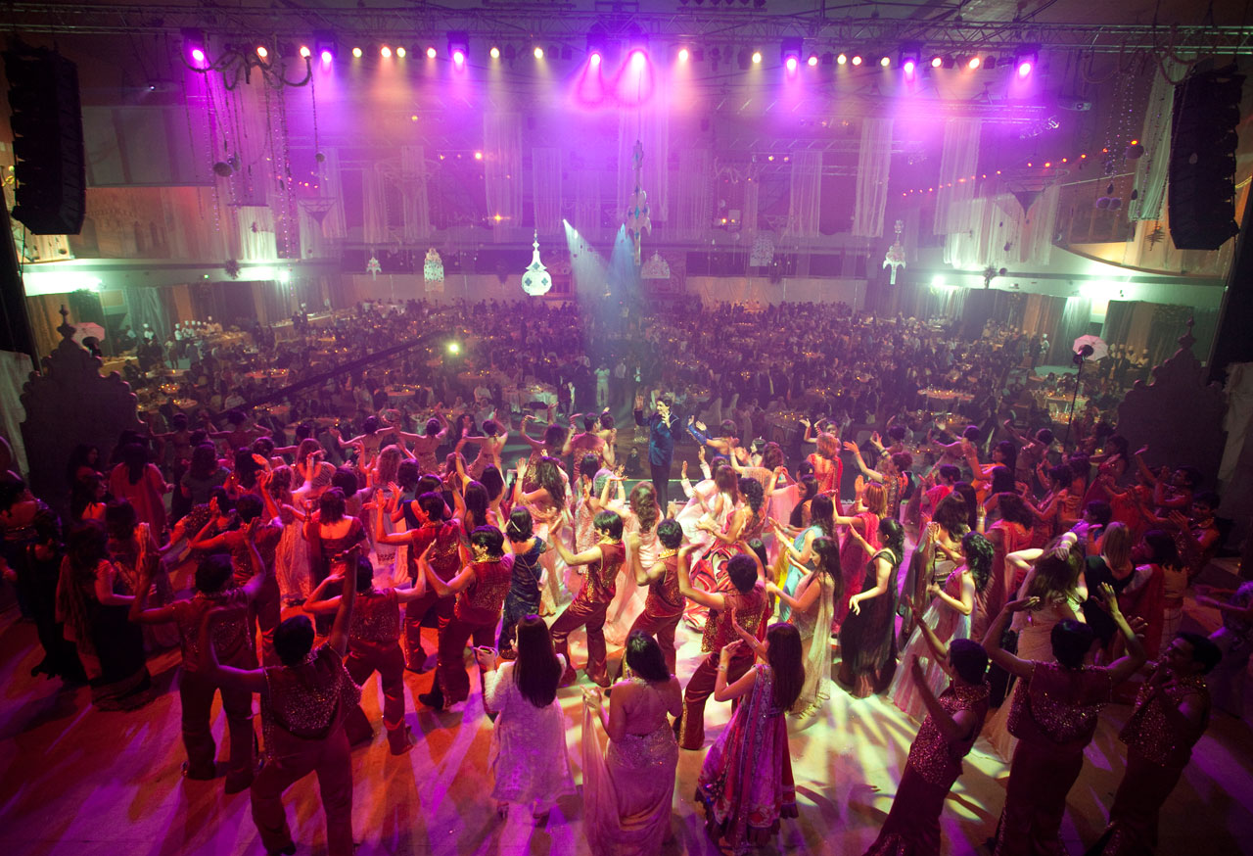
Bride and groom side families take part in dance. Songs are full of fun, teasing, love and praise for each other.

Slide 25
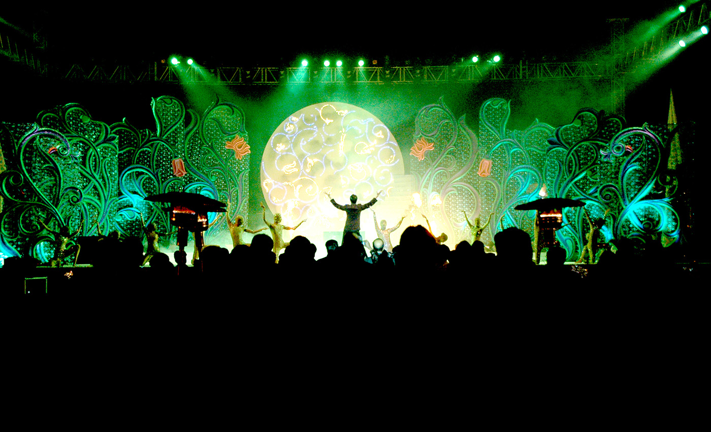
Wedding Stage Shows as per the desired requirements of our clients. These stage shows are organized under the supervision of dedicated professionals with proper planning.

Slide 26
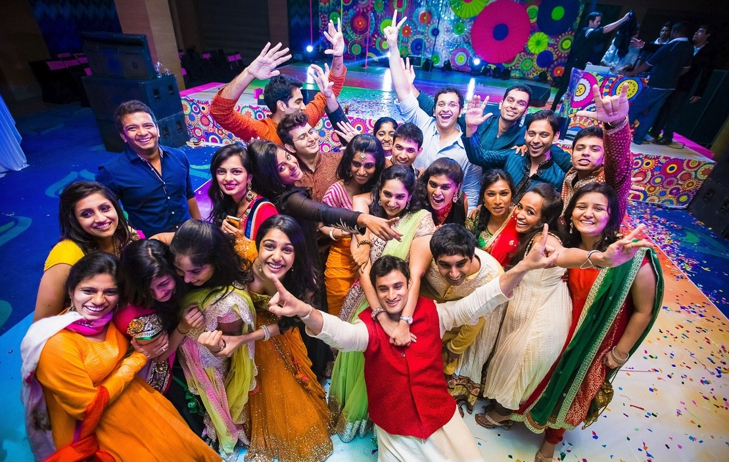
Indian wedding is the time to have fun and enjoyment Indian Marriage not only brings together bride and groom but their families also. ...

Slide 27
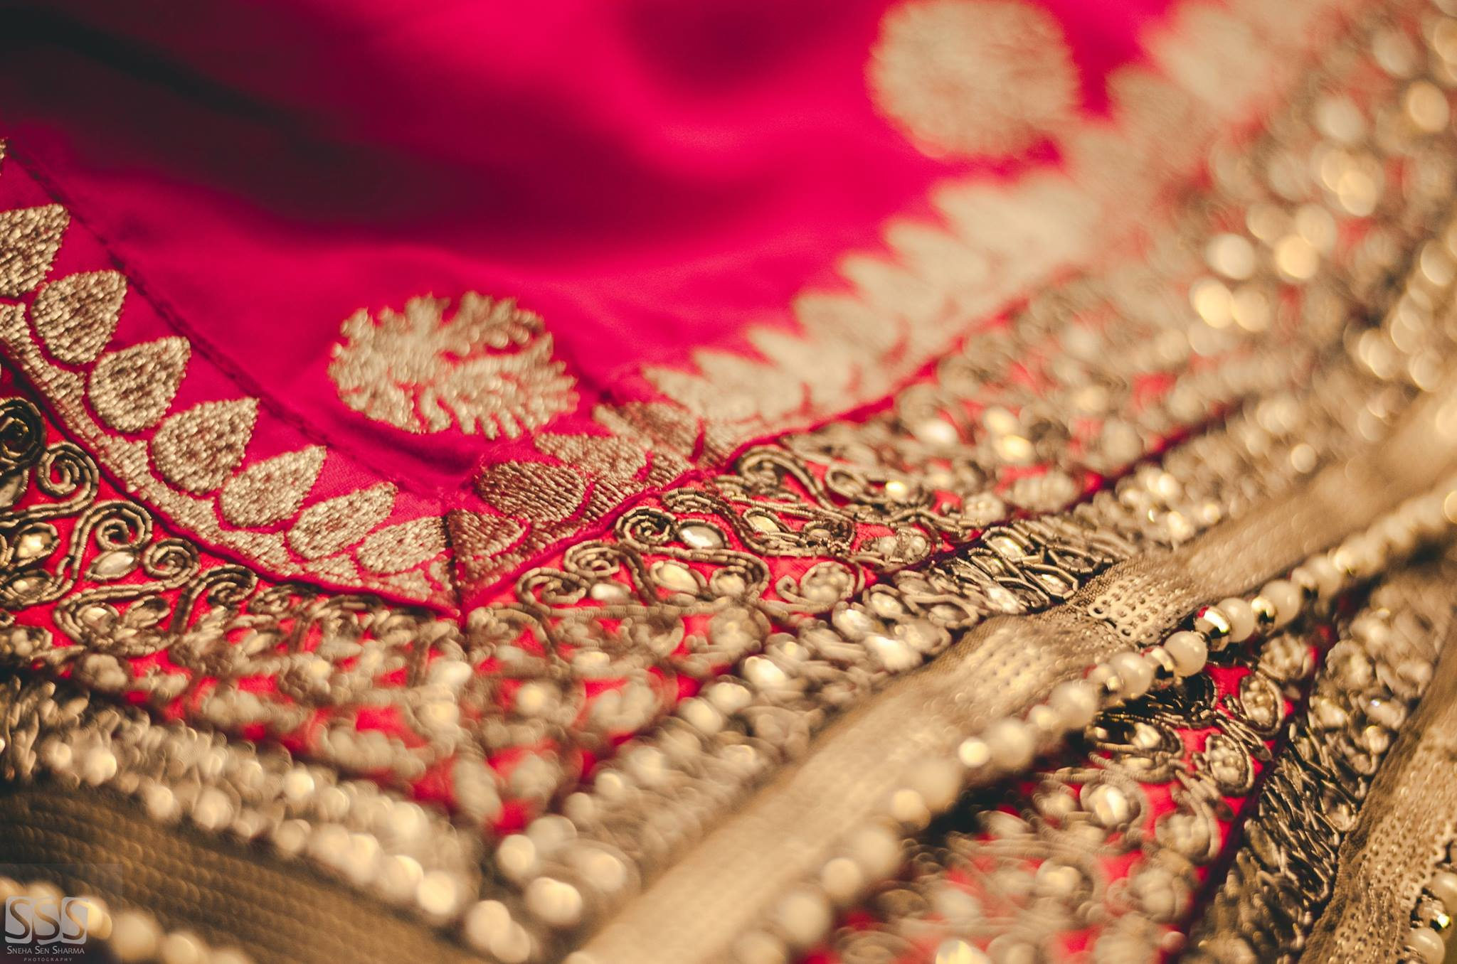
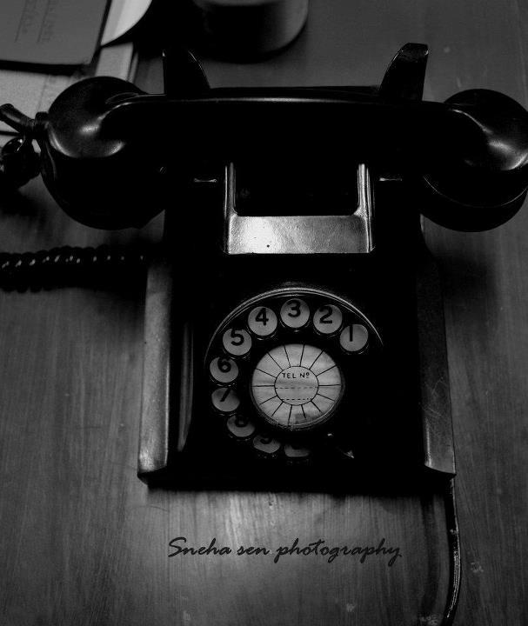
Contact Us
Sea Hawk Events Pvt. Ltd.
Add:- 244, 245, 2nd Floor, Vardhman Premium Mall,
Deepali, Pitampura- 110034
Phone: 011-27012745, +91- 9999986466 , +91- 9899382470
Email:- seahawkevents@gmail.com
Website:- www.seahawkevents.com
Social Sites Links:-
Facebook: https://www.facebook.com/Seahawkeventsind0007
Youtube: https://www.youtube.com/user/SeaHawkEvent

